Slide 1
CYCLISTIC PROJECT
Binh Nguyen

Slide 2
Contents
Business task
Approach and analysis
Technical challenges
Analysis
Results
Recommendation

Slide 3
Business Task
General purpose:
Maximizing the annual members for the company’s future success by converting the casual rides into the annual members
Business task:
Identify the differences between the way annual member and casual riders use Cyclistic bikes

Slide 4
Approach and Analysis
Data source: previous 12 months of Cyclistic trip data
Formatted, cleaned and import to SQL server for analysis
The columns ride_id, started_at, ended_at, member_casual, rideable_type will be considered to answer questions
Statistical inference and graphical visualization will be employed

Slide 5
Technical challenges
Trip data tables have missing values in the columns about location (start station, end station, latitude and longtitude) so the metrics of location can’t be considered
Trip data also will not be analyzed exactly about the use purpose of customers
The analysis will only focus on the differences about time metrics of trip of 2 customer types (annual members and casual riders) use Cyclistic bikes

Slide 6
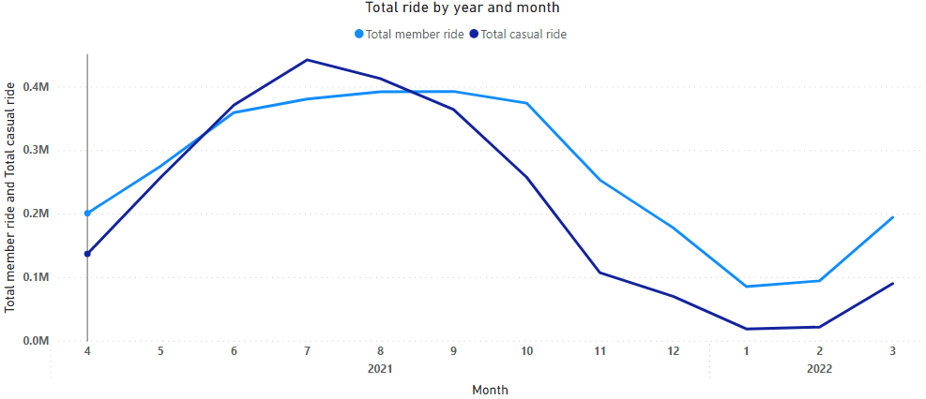
Total ride by year month
The trend of total ride amount do not show much the different between members and casual riders

Slide 7
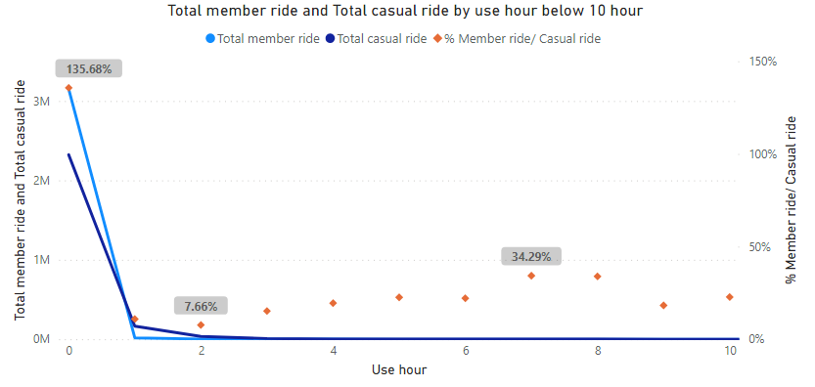
Total ride by use time (hour)
Below 1 hour: - 99.22 % of member ride and 91.23 % casual rider ride - Member ride is 35.68% more than casual ride → Focus on analyzing the member ride and casual ride below 1 hour

Slide 8
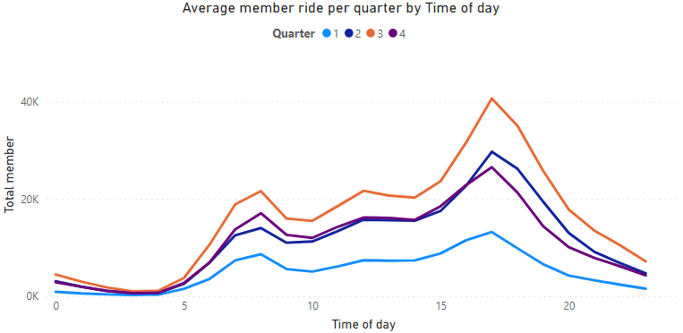
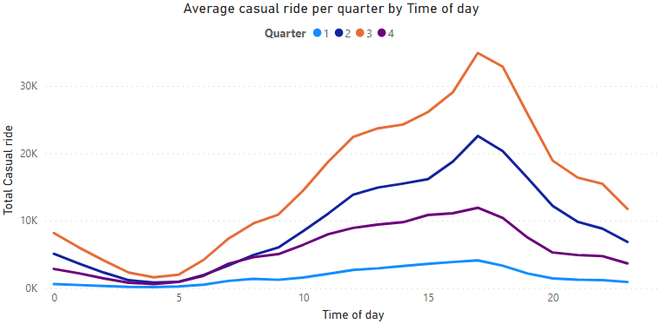
Ride by started time of day (use within 1 hour)
Members ride and casual riders ride by time of day have the same trend in each quarter
→ Compare average ride per month is acceptable

Slide 9
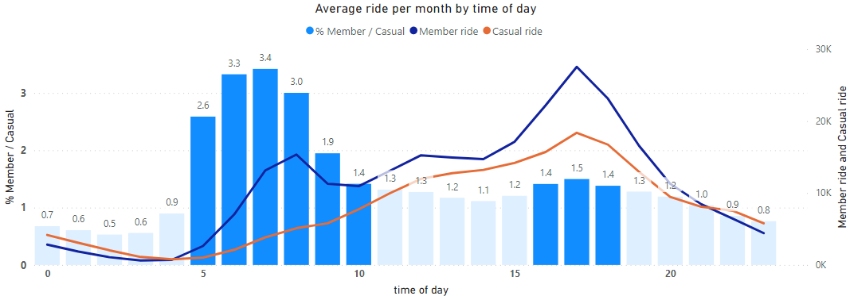
Ride by started time of day (use within 1 hour)
Members use bike more than casual riders at 5am – 9am (at least 2 times) and 4pm – 6pm (at least 40% more)

Slide 10
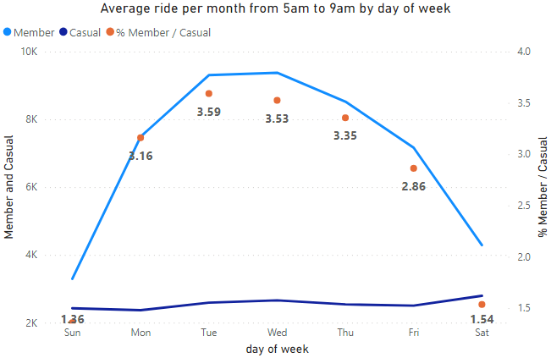
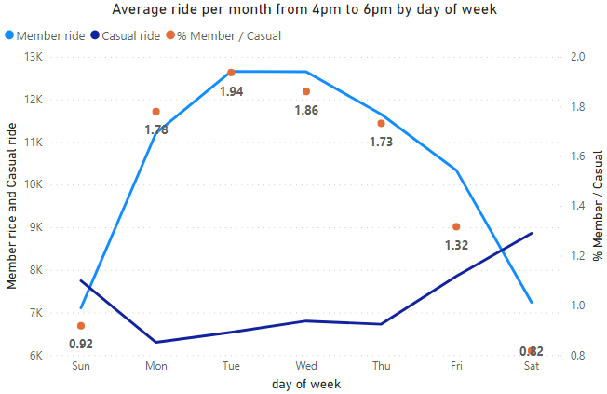
Ride by day of week (use within 1 hour)
With trip below 1 hour at 5am – 9am and 4pm – 6pm, annual member use more from Monday to Friday

Slide 11
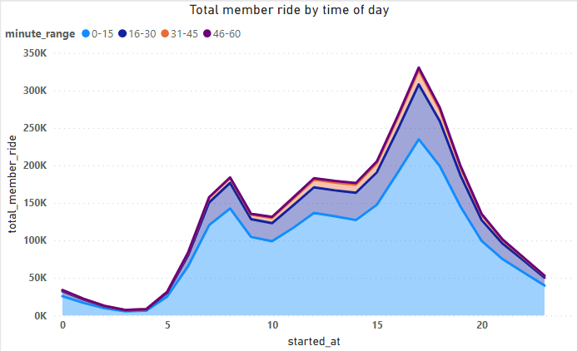
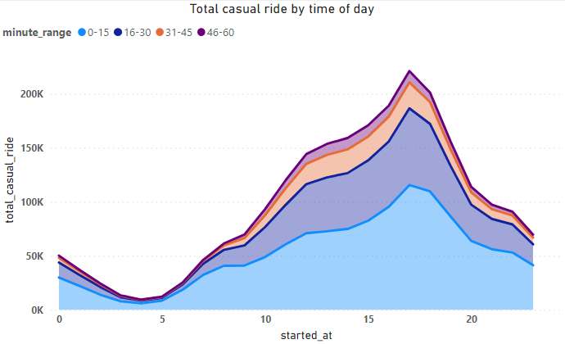
More about trip ride within 1 hour
Member trip: 0 - 15 minute: 73,85 % 16 – 30 minute: 20,09 %
Casual rider trip: 0 - 15 minute: 50,81 % 16 – 30 minute: 30,21 %

Slide 12
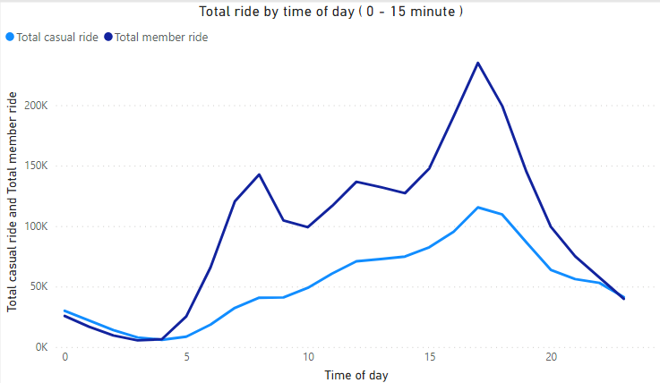
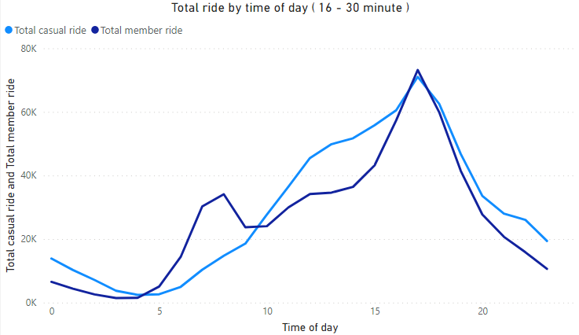
More about trip ride within 1 hour
With trip within 30 minutes: - Members use more than casual rider at 5 am – 9 am - Members and casual riders both use much at 4 pm – 6 pm (especially 16 – 30 minutes trip)

Slide 13
Final results
Annual members use Cyclistic bike for short trip (within 30 minutes) – 93,22 % member ride vs 72,98 % casual ride
With short trip, annual members use significantly different from casual rider at 5 am to 9 am from Monday to Friday
Annual members and casual riders both use much at 4 pm to 6 pm from Monday to Friday

Slide 14
Recommendation
For converting into annual members, focus to casual riders use Cyclistic bikes:
Within 30 minute at 4 pm – 6 pm
Within 30 minutes at 5 am – 9 am from Monday to Friday

